Slide 1
“Integrated Electronic Case Management System in Rwanda” By Niceson Karungi Director IT Support The Judiciary of Rwanda
Timely, Quality and Accessible Justice

Slide 2
IECMS INTEGRATES JUCTICE SECTOR INSTITUTIONS
Police
NPPA
Judiciary
Citizens / Advocates
Minijust
CS
Timely, Quality and Accessible Justice

Slide 3
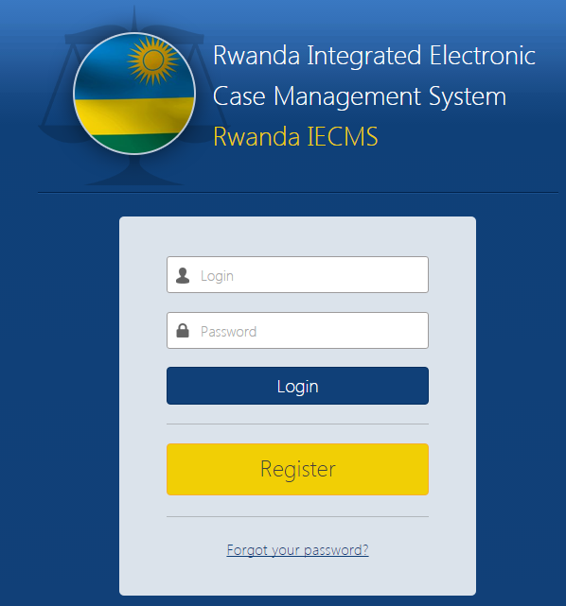
What is IECMS (Integrated Electronic Case Management System)
Designed by Synergy International Ltd, an American company based in Armenia in collaboration with local Justice sector institutions.
IECMS replaced previous case management soft wares Registre de Dossier Judiciaire (2006-2010), Electronic Filing System (EFS: 2010-2016) Electronic Record Management System (ERMS: 2016) which were proven not fit to process and follow up cases from filing to closure.
System development started in January 2015, Initial System development completed in October 2015.
Timely, Quality and Accessible Justice

Slide 4
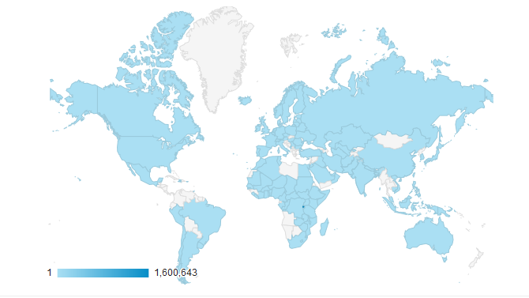
IECMS is already effective
IECMS Currently deployed in all courts
Phase 1 launched January 2016 with 16 courts (15 courts plus High Court Chamber of International Crimes (HCIC))
phase 2 launched in September 2016 with 29 courts (all higher courts including 16 primary courts)
Phase 3 launched in June 2017 with 38 primary courts
Highest accessibility 1,600,643 Country: Rwanda, Armenia, USA, Uganda,UK, Netherlands, Kenya, Sudan, Belgium Mobile devices: Apple Ipad, Apple Iphone, Techno, Blackberry, Samsung Browser: Firefox, Chrome, Internet Explorer, Opera
Timely, Quality and Accessible Justice

Slide 5
Key Factors for Success (System Adoption)
Leadership Commitment
Deploying from the End –The Court application was rolled out first, which created a demand for data from the prosecution. When the prosecution began using the system, it placed a demand on the police to provide data.
Focusing Forward – When IECMS was launched, the Judiciary instructed that from that point forward, each new court activated on the IECMS would receive new cases in the electronic format
Training of Trainers – A Training of Trainers model was used to reach the large number of users. Some forty trainers were trained to support ongoing efforts at bringing new users online. A separate team of administrators received advanced technical training over a period of seven weeks so that they could monitor and maintain the system independent of developer intervention.
Timely, Quality and Accessible Justice

Slide 6
Technical Support and ways around it
Addressing Capacity Constraints – Even with a strong team of trainers, resources were limited when bringing the IECMS to scale.
Established a mailing list which enabled users to share problems, questions, and solutions.
Confronting Institutional Resistance to Change – As with any CMS implementations, court staff and judges are naturally resistant to change.
Scheduled meetings of court leaders on a quarterly basis to learn from their peers experience and attract new buy ins.
Timely, Quality and Accessible Justice

Slide 7
Training of Staff and other stakeholders
Training of trainers
Trainings were conducted in phases even as deployment was in phases
Training of registrars and judges in one location
Training of staff on site as soon as system was deployed
Training of lawyers, cyber café members and MAJ (theory and practice)
Numerous trainings at request

Slide 8
Interactions with public
Promoting Public Awareness and language constraints –educating nearly 13 million inhabitants about the new IECMS.
Judiciary turned to the local radio stations, national network televisions, and local newspapers to educate litigants about IECMS.
National talk shows both before and during the launch of IECMS to promote awareness of court users .
User manuals and tutorial videos on YouTube in both English and Kinyarwanda.
Providing Access to eJustice – The Judiciary of Rwanda was aware that only about 20% of the population has a reliable internet connection.
Judiciary involved the training of youth “facilitators,” who could more easily adopt the new technology, and would be able to offer their services in support of new users.
Training of facilitators and cyber cafes
Training of MAJ employees, enabling them to file or follow-up on cases free of charge for very poor citizens.
Existing Irembo staff
Timely, Quality and Accessible Justice

Slide 9
IECMS Developments in pipeline: system is still ongoing.
Execution of civil cases
E-signature
integration with Irembo for online payment with visa card.
Future integrations are envisioned with other information systems and institutions, such as the Court Bailiffs, National Identification Agency (NIDA), Rwanda Development Board, Rwanda Law Reform Commission and Law Library, to permit easy access to shared information directly through the IECMS.
Timely, Quality and Accessible Justice

Slide 10
Conclusion
Rwanda is unique in attempting a unified system from the start, which intensified the need for efficient local coordination and left little room for error.
Phased approach for system roll out. Enabling the judiciary to learn and apply best practices from one phase to the next.
Focused leadership, a positive reception by the population, and a firm political commitment to embracing technology as a driving tool for development.
Timely, Quality and Accessible Justice

Slide 11
Award and recognition
Continental public management Award, International gold trophy , just 3 months after its launch in 2016, for being the best demonstration of innovative public management in Africa. The award was organized by the African Association of Public Administration Management (APAAM).
IECMS was also awarded the 5th Technology Solution Award at the joint conference of the National Association of Court Administrators and the International Association of Court Administrators in July 2017, at Washington DC, USA
Cited by the World Bank as the primary factor causing Rwanda’s ranking in the Enforcing Contracts section of the Doing Business Report to rise 22 positions between 2016 and 2017.
Rwanda is now ranked second in Sub-Saharan Africa for ease of doing business, and now has the highest Quality of Judicial Processes Index score in the region, even higher than the average for OECD High Income countries. On average, it takes less than half the time to enforce a contract in Rwanda as it does in the average OECD High Income country.
Timely, Quality and Accessible Justice

Slide 12

THANK YOU
Timely, Quality and Accessible Justice

